Slide 1
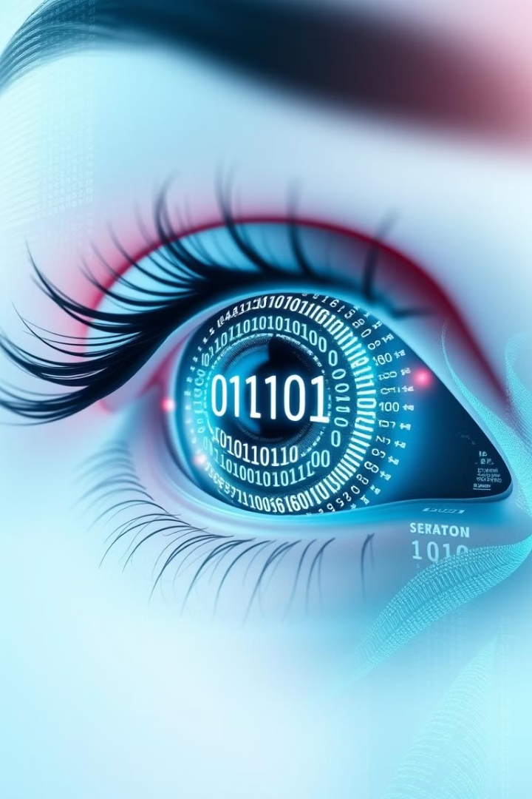

Secure Data Hiding in Images Using Steganography
This presentation explores the innovative use of steganography for secure data hiding within images. We delve into the necessity, technology, and unique aspects of our approach, highlighting the benefits for end-users and showcasing our results.

Slide 2
Presented By: edunet foundation
Student Name : Nisha Kumari
College Name: Birla institute of applied sciences, Bhimtal Department : Computer sciences and engineering

Slide 3
OUTLINE:
Problem Statement
Technology used
Wow factor
End users
Result
Conclusion
Git-hub Link
Future scope

Slide 4
The Problem: The Necessity of Secure Data Hiding
Data Breaches
Privacy Concerns
Secure Communication
Data breaches are becoming increasingly common.
Individuals are increasingly concerned about their privacy.
Secure communication is vital.
Data breaches and privacy concerns highlight the necessity of secure data hiding. Steganography offers a solution by embedding data within images, providing a covert channel for secure communication.

Slide 5

Technology Used: Algorithms and Tools
1
LSB Algorithm
2
Discrete Cosine Transform
Least Significant Bit manipulation.
Frequency domain embedding.
3
OpenStego
A steganography tool.
Our project uses LSB and DCT algorithms, and tools like OpenStego. These tools are employed to ensure robust and secure data hiding within image files.

Slide 6




Wow Factors: Unique Aspects of Our Approach
Enhanced Security
High Capacity
Invisibility
Embedding large amounts of data.
Data hidden imperceptibly.
Multi-layered encryption provides additional protection.
Our approach offers enhanced security with multi-layered encryption. We achieve high capacity for data embedding, and ensuring complete invisibility for covert communication.

Slide 7

End Users: Who Benefits from This Technology?
Journalists
Protect sources and sensitive information.
Healthcare
Securely share patient records.
Military
Confidential communications.
Law Enforcement
Covert data transfer.
Our technology benefits journalists, healthcare providers, and the military by offering secure ways to protect sources, share records, and maintain confidential communications.

Slide 8
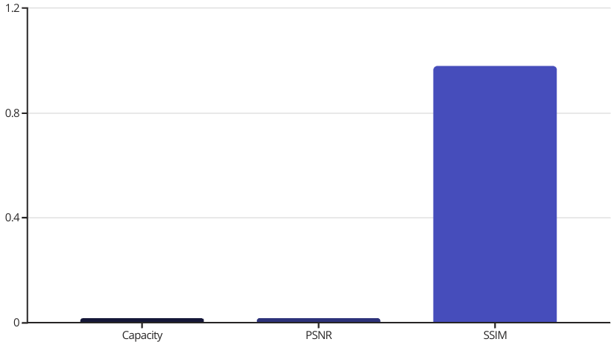
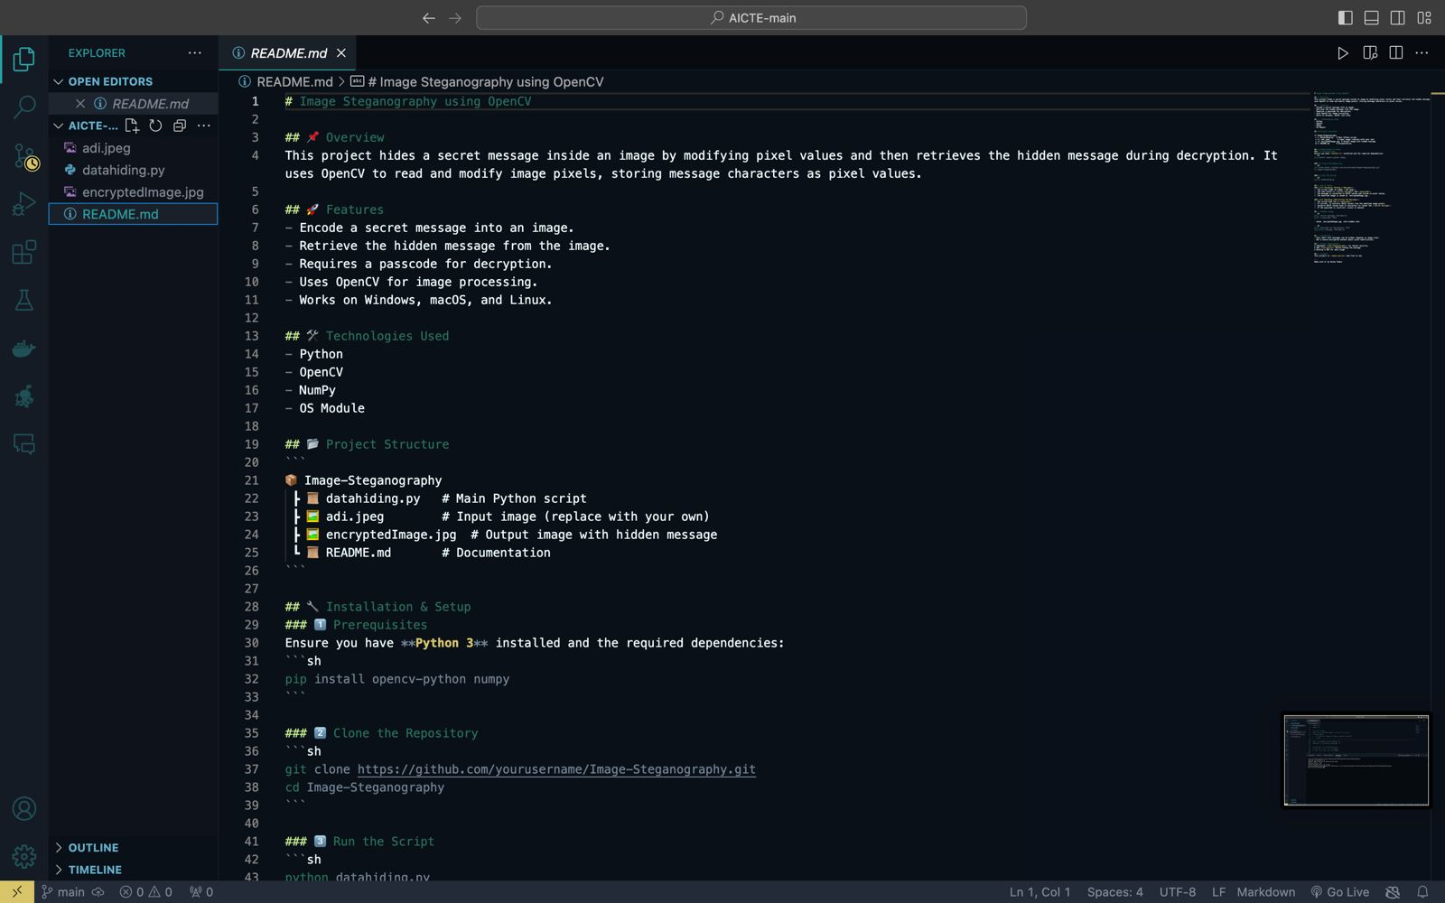
Results: Performance Metrics and Visualizations
Metrics include a data capacity of 250KB and a PSNR of 45dB. We also have an SSIM of 0.98. These results demonstrate the efficacy and quality of our steganographic method.

Slide 9
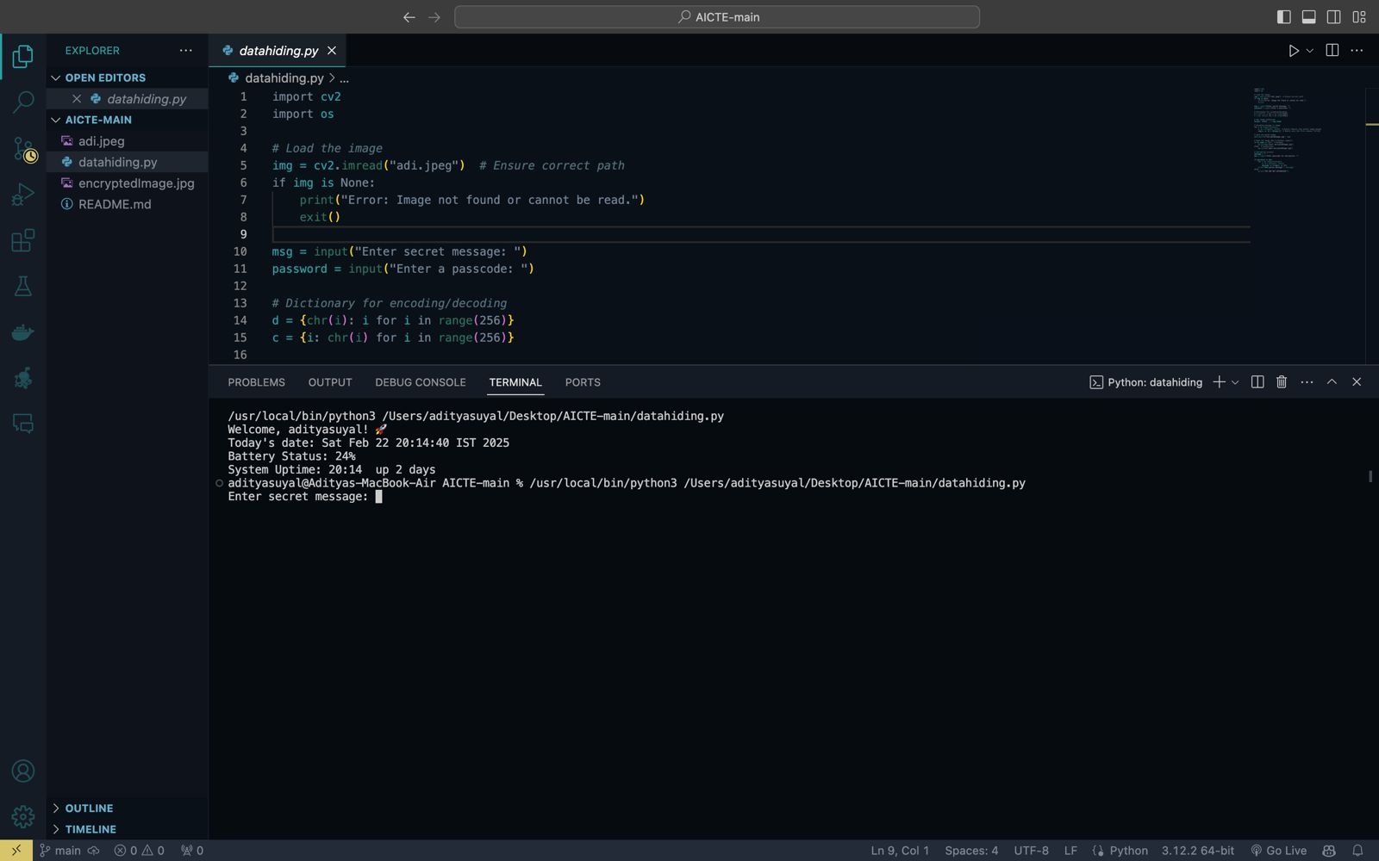
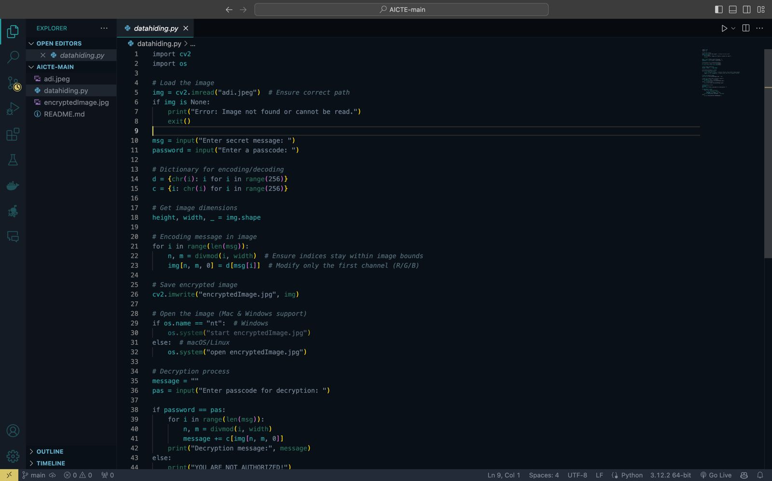

Slide 10




Conclusion: Summary and Future Directions
Achieved Goals
Secure data hiding in images.
Future Work
Implement more robust algorithms.
Applications
Expanded range of secure communication.
We achieved secure data hiding. Future work includes more robust algorithms. Expanded secure communication can be achieved.

Slide 11

GitHub Repo Link: Access the Code!
Explore and contribute to our project on GitHub. Access the code, documentation, and examples to implement secure data hiding in images. Enhance your security with our tools and algorithms.
https://github.com/nishathakur-13/AICTE

Slide 12

Future scope
1. AI and Machine Learning Integration 2.Quantum Steganography
3. Blockchain for Secure Data Transmission
4. Hybrid Cryptography and Steganography
5. Improved Robustness Against Attacks

Slide 13
THANK YOU

